Slide 1
Cell Type Deconvolution
18 August 2020

Slide 2
How does it work?
Leverages cell type-specific DNAm profile.
Can be reference-based or non-reference-based.
Reference-based: Uses a reference dataset consisting of cell types with known proportions (either from Magnetic-Activated Cell Sorting (MACS) or Fluorescence-Activated Cell Sorting (FACS)) and specific DNAm signatures to infer cell proportions of heterogenous cell mixture.
Captures approximately 90% of total white blood cells in 6 cell types of the reference datasets
Two methods to choose reference libraries: Auto (from minfi) or IDOL.

Slide 3
Library Selection Methods

Slide 4
Auto
IDOL
Chooses the top 100* most differentially methylated probes (50 hyper & 50 hypo-) for each cell type.
*However, in cord blood, the selection of probes is agnostic of the direction of DNAm direction, resulting in 600 – 700 top differentially methylated probes for different datasets depending on filtering, whether nRBC is included, and combination of references
Iterative algorithm that dynamically scans a candidate set of cell-specific DNAm probes that are optimized to accurately estimate cell types.
Recommended method due to lower bias, RMSE and absolute errors.

Slide 5
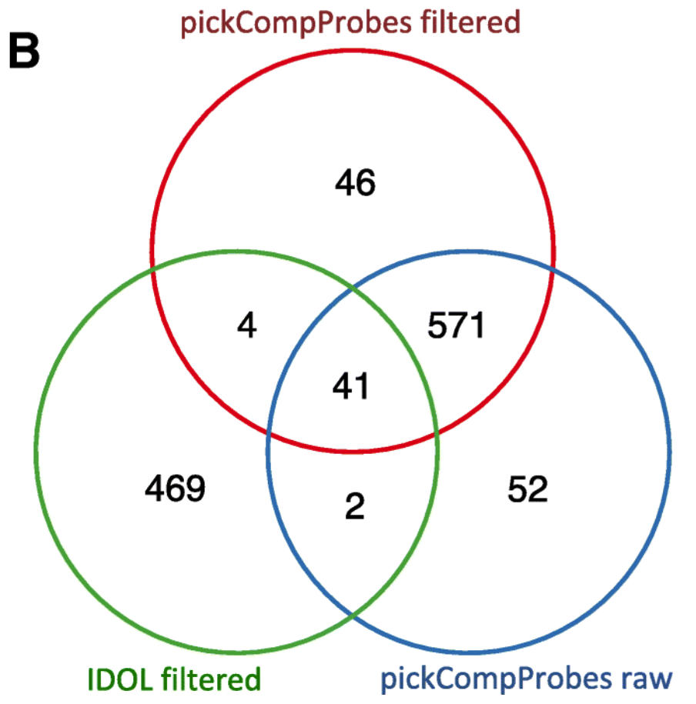
Probe Overlap between Methods
In FlowSorted.CordBlood-Combined.450K, Gervin et al. (2019)

Slide 6
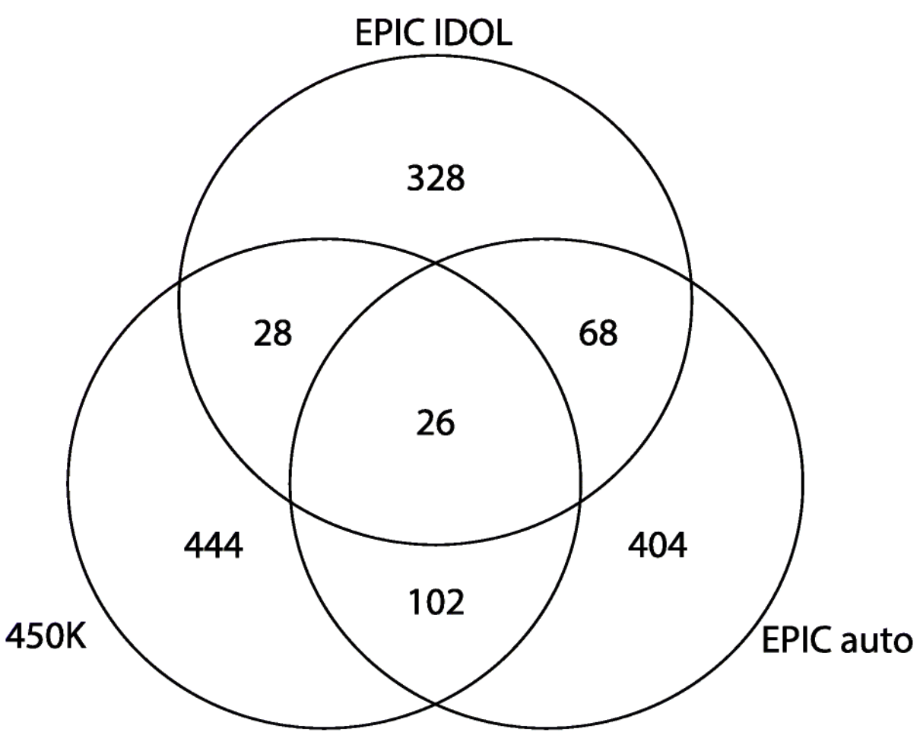
Probe Overlap between Methods & Array
In FlowSorted.Blood.450K/EPIC, Salas et al. (2018)

Slide 7
FlowSorted.CordBlood-Combined.450K
Gervin et al. (2019)

Slide 8
Features
Combination of 4 cleaned cord blood reference datasets: Bakulski reference, de Goede reference, Gervin reference, Lin reference.
Cell types: B cells (N = 42), CD4T cells (N = 41), CD8T cells (N = 33), Gran (N = 43), Mono (N = 48), NK cells (N = 45), nRBC (N = 11) [Biological differences].
Cell counts and purification methods: MACS (Bakulski, Lin), FACS (de Goede, Gervin) [Technical differences].
Notes:
CD8T estimates – less accurate regardless of library selection method – because T cells in cord have very similar DNAm patterns, and do not display specific cell-type patterns until maturity.

Slide 9
FlowSorted.Blood.450K*/EPIC**
*Jaffe & Irizarry (2013)
**Salas et al. (2018)

Slide 10
Features
Cell types: Neu (N = 6), Mono (N = 6), B cells (N = 6), CD4T cells (N = 6 & 1 tech rep), CD8 T cells (N = 6), NK cells (N = 6).
Average purity across samples: 95% (Range: 88% - 99%) [Mono has the lowest purity].
Lowest R² estimate: CD4T (95.5%) [IDOL, EPIC]. R² estimate improves with auto selection method with EPIC (98.1%).
Notes:
Based on FlowSorted.Blood.450k: 6 adult males, purified with flow cytometry and profiled using HM 450K.

Slide 11
CANDLE Cell Type Deconvolution

Slide 12
Summary
First 100 samples.
Cord blood.

Slide 13
Comparing library selection methods for each reference dataset

Slide 14
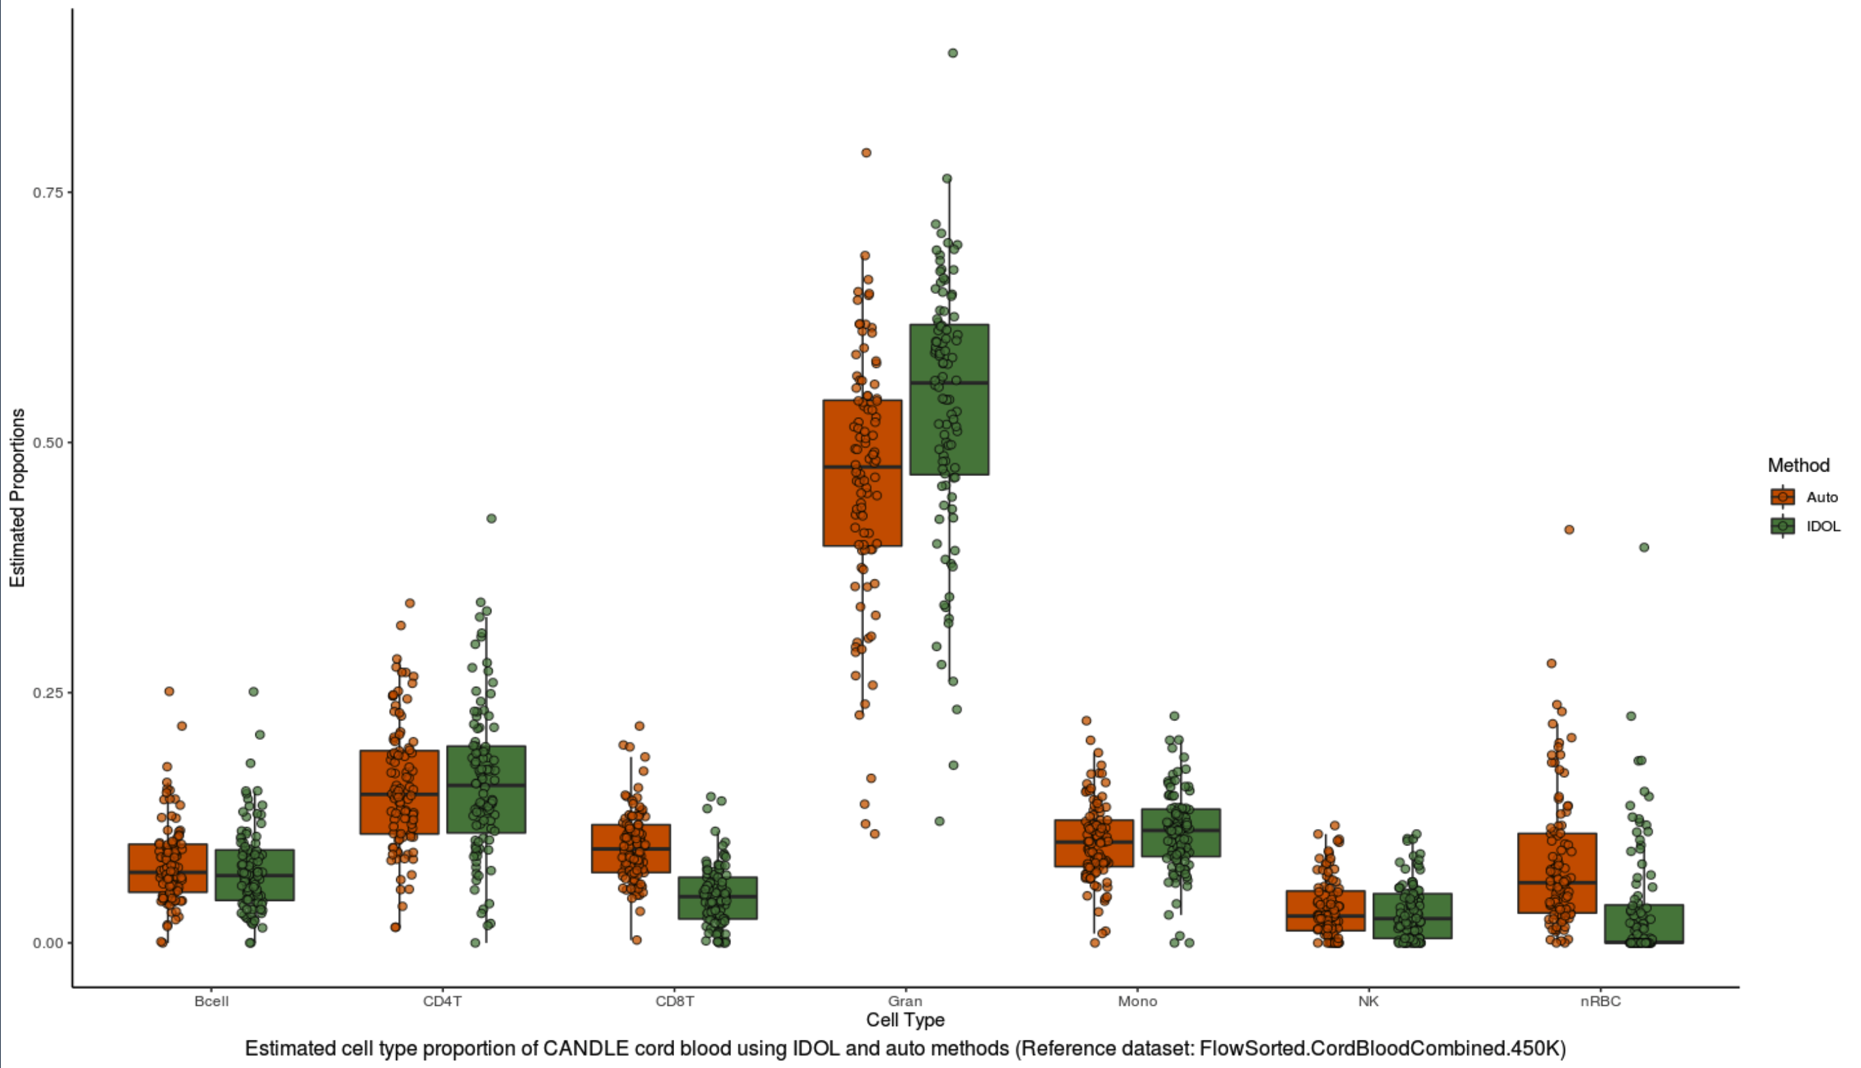
Reference dataset: FlowSorted.CordBloodCombined.450K

Slide 15
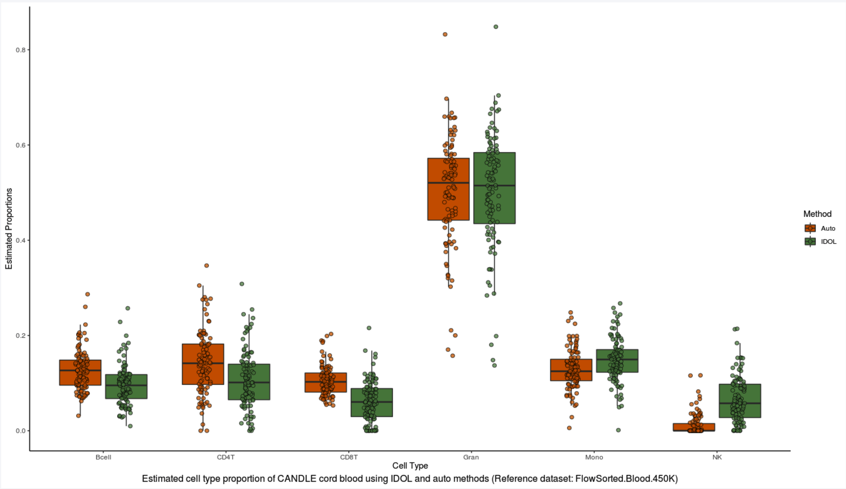
Reference dataset: FlowSorted.Blood.450K

Slide 16
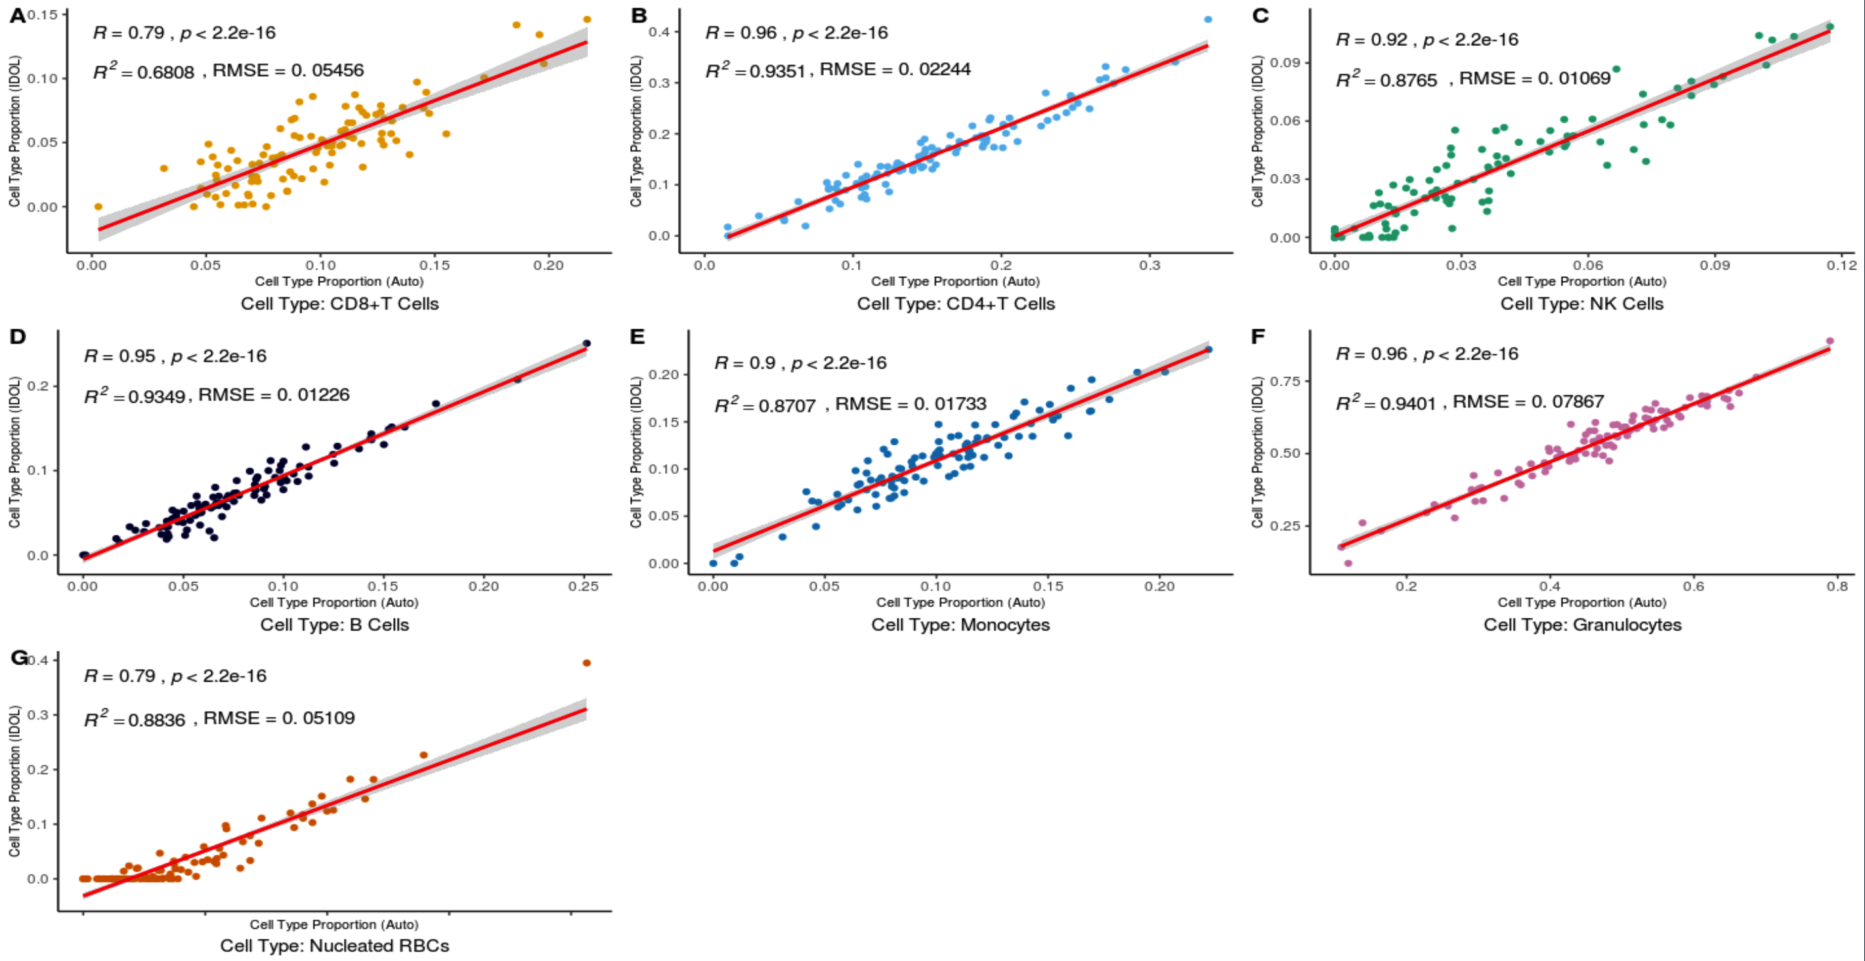
Reference dataset: FlowSorted.CordBloodCombined.450K
Notes:
CD8T estimates – less accurate regardless of library selection method – because T cells in cord have very similar DNAm patterns, and do not display specific cell-type patterns until maturity.

Slide 17
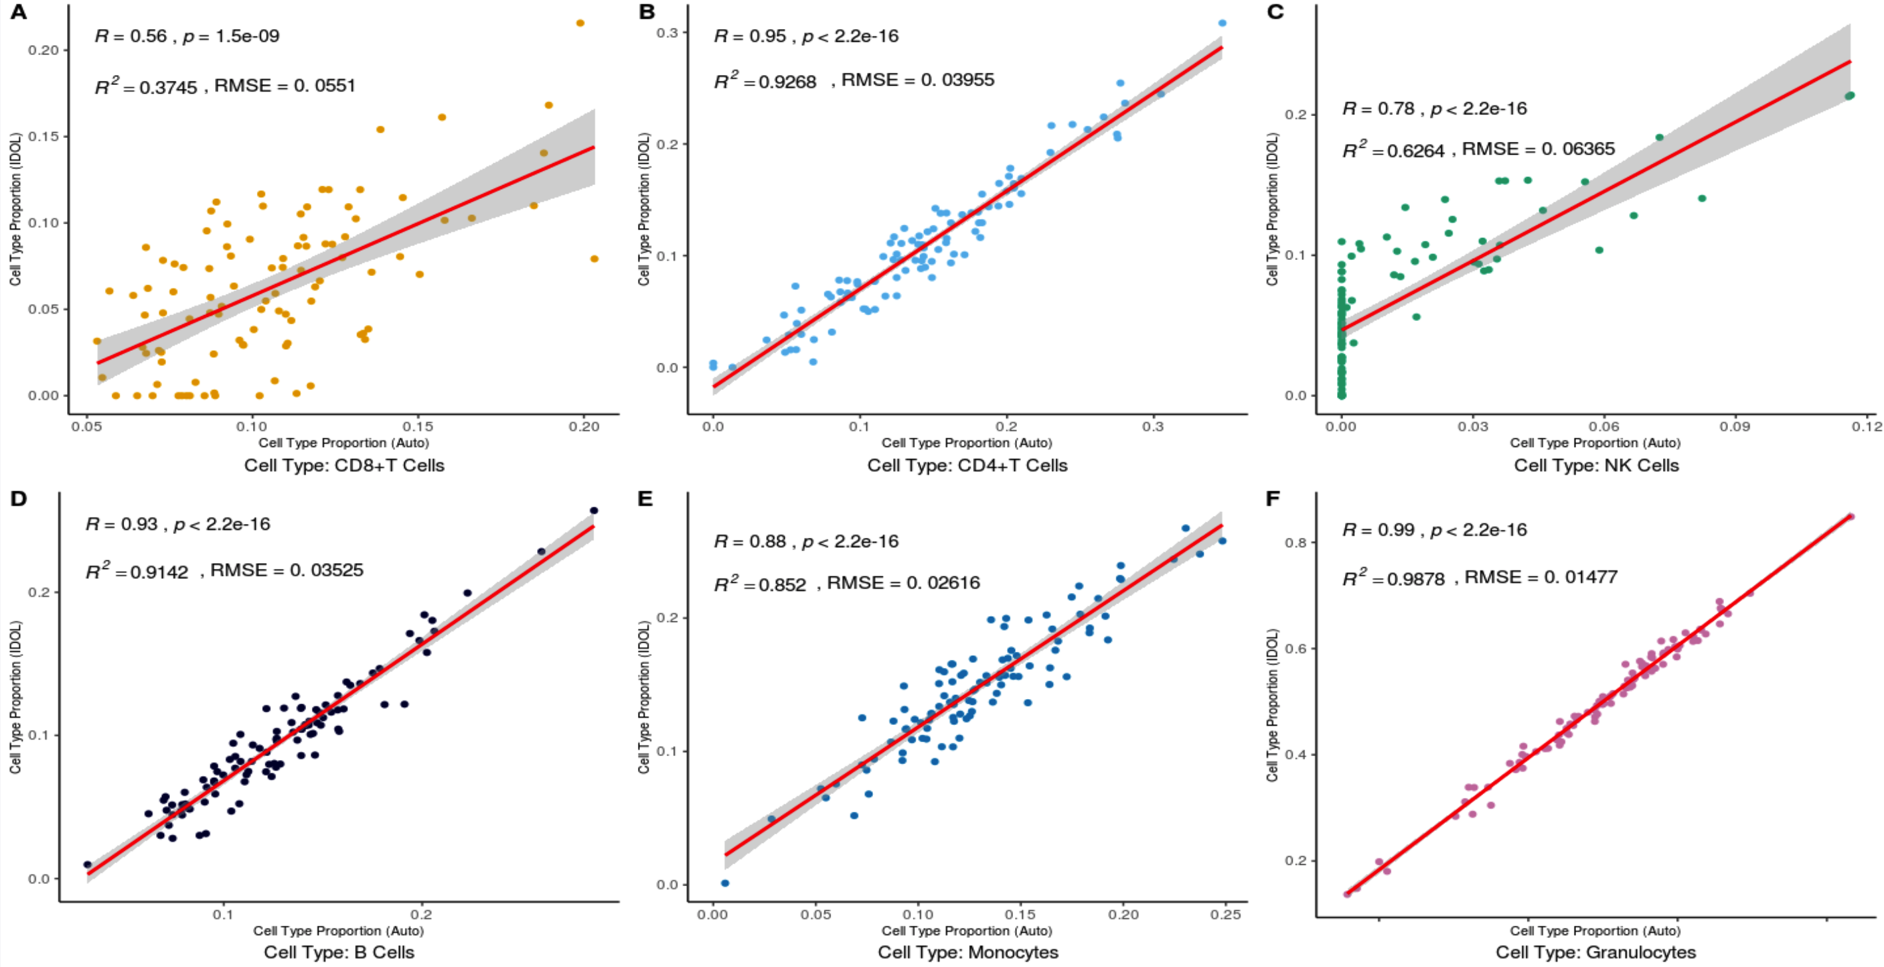
Reference dataset: FlowSorted.Blood.450K
Notes:
CD8T estimates – less accurate regardless of library selection method – because T cells in cord have very similar DNAm patterns, and do not display specific cell-type patterns until maturity.

Slide 18
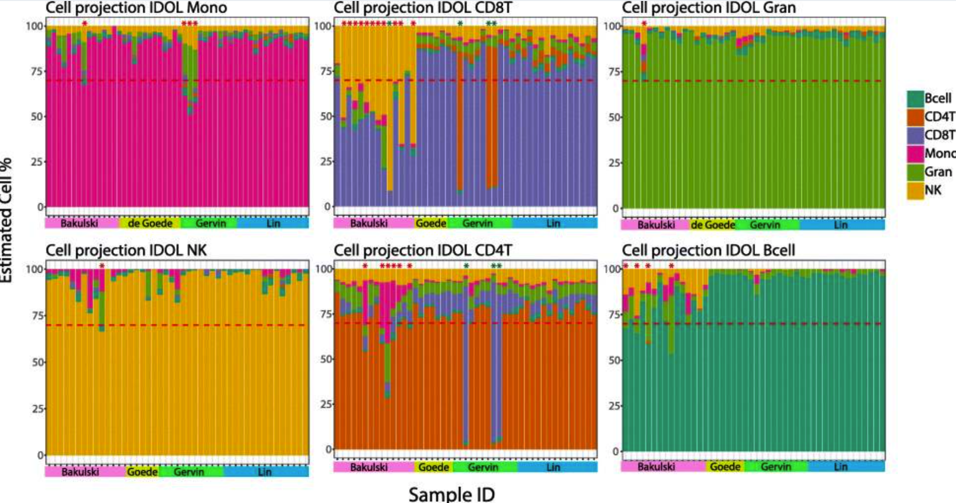
Gervin et al. (2019)

Slide 19
Comparing cell-type estimates between reference datasets

Slide 20
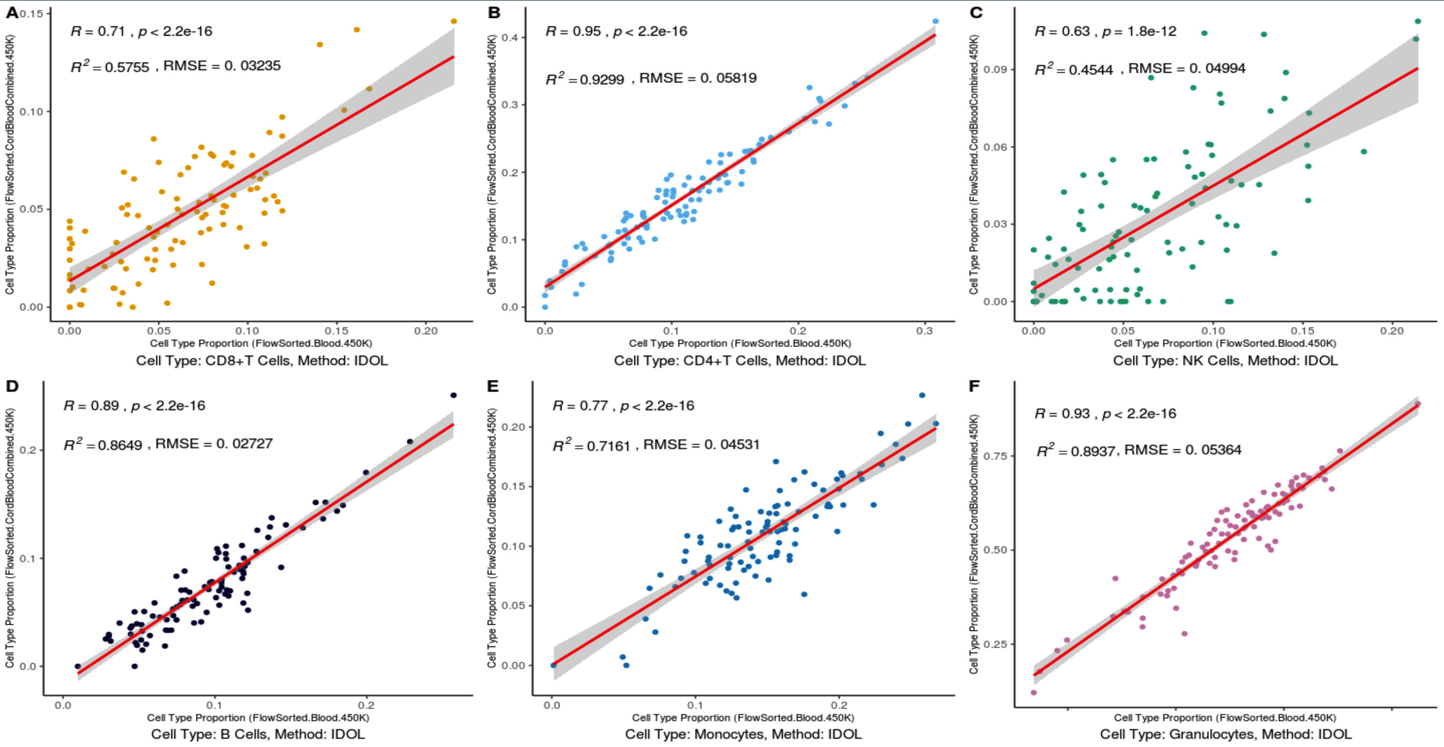
L-DMR Library Selection Method: IDOL

Slide 21
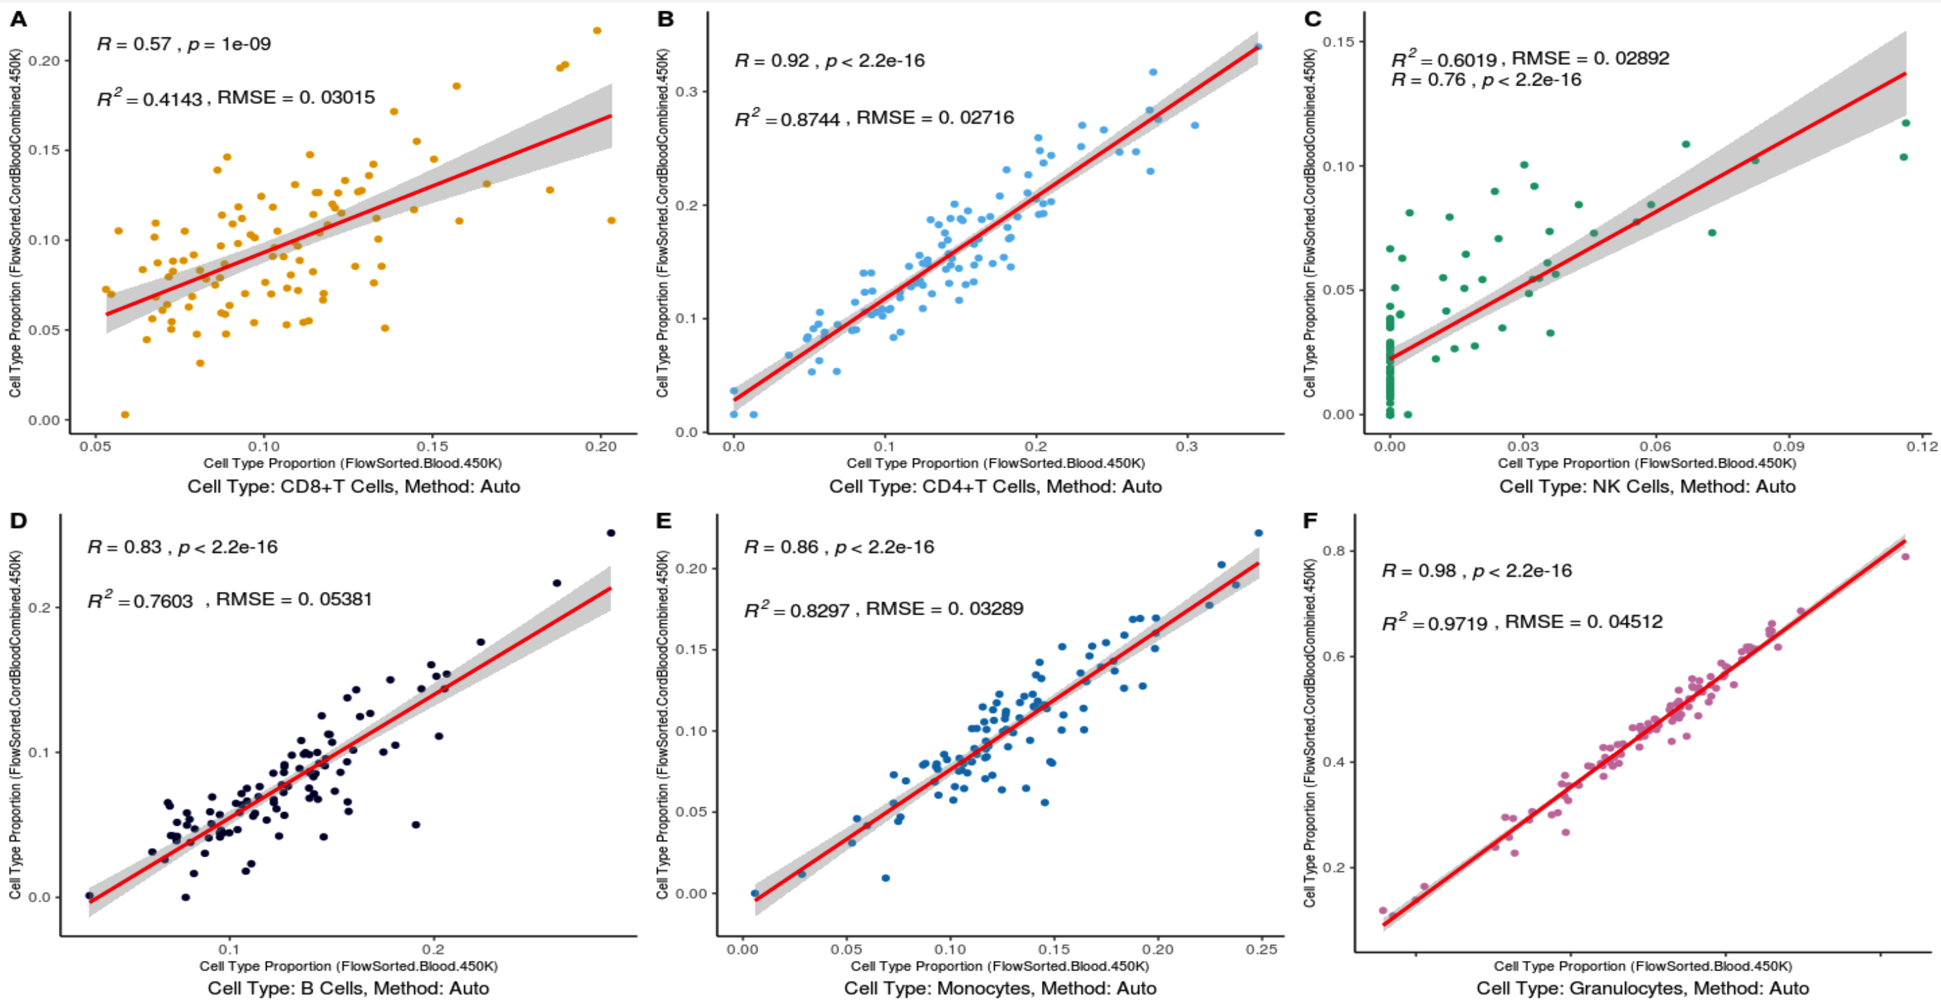
L-DMR Library Selection Method: Auto

